Slide 1
Session starting soon

Slide 2

Welcome To Day <6/>

Slide 3

About the Mentor
Sagar Kumar Jha is an accomplished professional with diverse experience across high-impact organizations.
Interned at DRDO, focusing on APK & API Security.
Interned at the Special Protection Groups(SPG), specializing in Radar Communication Systems.
Interned at NITI Aayog, contributing to Software Engineering projects.

Slide 4

About the Instructor
Divyansh Raj is a skilled professional currently serving as the Technical Lead of GDGC and an intern at Delhi Government University, showcasing his expertise in technical leadership and project execution.

Slide 5



Connect With Us !
Sagar Kumar Jha
(Mentor)
Divyansh Raj
(Instructor)

Slide 6
Day 6: NodeJS
Build Fast, Scale Smart, Code Seamlessly!

Slide 7
Let’s Start!
NodeJS:
A JavaScript runtime built on Chrome’s V8 JavaScript engine
Allows Execution of JavaScript code outside the browser. Designed for building scalable, high-performance applications.

Slide 8
Introduction to Node Js
Key Features
Event-driven and non-blocking I/O.
Single-threaded with efficient handling of multiple requests.
Built-in support for package management via npm.
Advantages
Asynchronous and scalable.-
Huge ecosystem of libraries via npm.
Ideal for microservices and real-time applications.
Disadvantages
Callback hell in older implementations.
Not suitable for CPU-intensive tasks.
Use Cases
- Web servers, APIs, real-time chat applications, and tools like CLI applications.

Slide 9
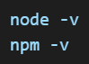
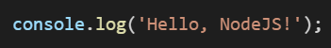
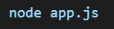
2. Setting Up NodeJS
Installation
Download from NodeJS Official Website (https://nodejs.org)
Verify Installation:
Running a NodeJS Application
Create a file app.js
Execute using:

Slide 10
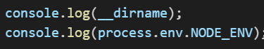
3. NodeJS Basics
JavaScript in NodeJS
Difference between NodeJS and Browser JavaScript
- No DOM or window object in NodeJS
- NodeJS Provides access to system resources
Global Objects in NodeJS
Key objects and their uses
- __dirname and __filename: Provide current directory and file path
- process: Access environment variables and arguments.
- console: Outputs logs or errors.

Slide 11
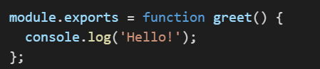
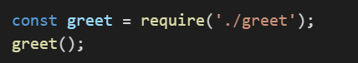
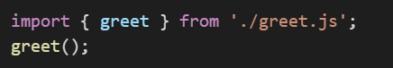
Modules and Require
CommonJS modules
- Exporting:
- Importing:
ES modules
- Exporting:
- Importing:

Slide 12
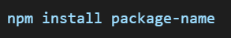
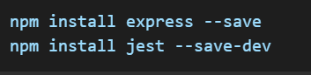
Npm (Node Package Manager)
Installing a package:
Types of Dependencies:
- dependencies: Required for production
- devDependencies: Required for development
Example:
Semantic Versioning:
^ : Updates within the same major version.
~ : Updates withing the same minor version

Slide 13
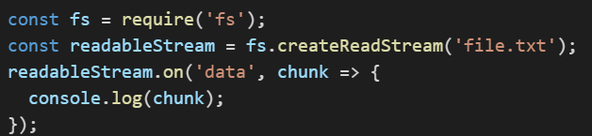
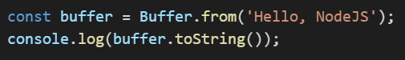
Event Loop
Explanation of phases:
Timers
Pending Callbacks
Idle, prepare
Poll
Check
Close callbacks
Streams and buffers
What are Streams?
- Used for reading and writing data piece by piece
- Types: readable, writable, duplex and transform
- Example:
- Buffers: Temporary storage for stream data

Slide 14
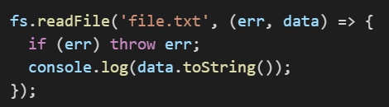
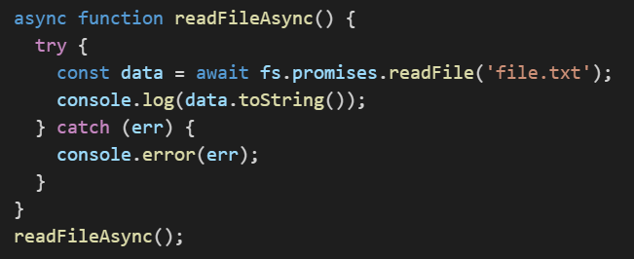
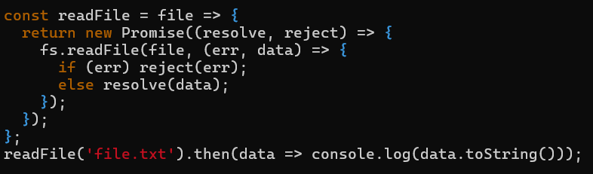
4. Asynchronous Programming
Callback Functions
Example:
Promises
Example:
Async/Await
Example:

Slide 15
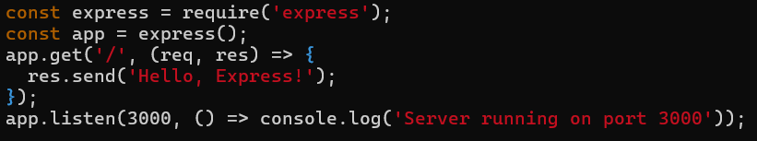
5. Express.js Basics
Setting up Express
Installation: npm install express
Basic Example:
Middleware: A function that acts as an intermediary between the software layers of an application
- Purpose: Middleware enhances application functionality by incorporating custom logic,
performing preprocessing tasks and managing various aspects of the
request-response flow.

Slide 16
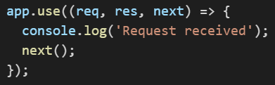
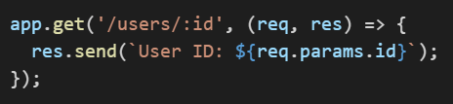
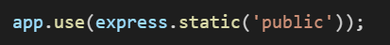
Types of Middleware:
Application level
Router level
Built-in
Error handling
Example:
Routing:
Static File Serving:

Slide 17
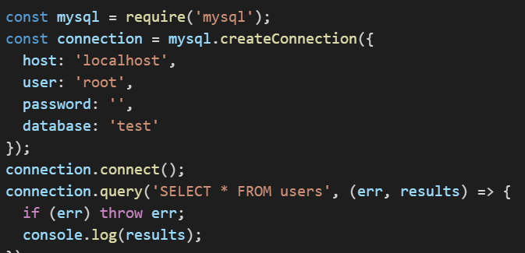
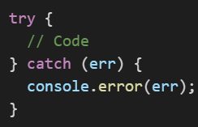
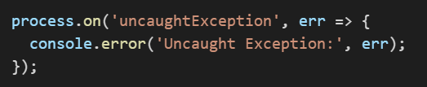
6. Advance Topics
Database Integration
Using MySQL:
Error handling: Asynchronous Synchronous

Slide 18
Thank You!
That’s all for today!
The fun is in the journey, success is just a place to be at.

